Slide 1

Twitter Profiling Using LLM's
Twitter profiling using Large Language Models (LLM's) has become increasingly popular for understanding user behavior and preferences. LLM's can process vast amounts of text data, allowing for in-depth analysis of Twitter users' posts, interactions, and networks.
This project aims to develop a system for profiling Twitter users by analyzing their tweets. The goal is to extract valuable attributes like hobbies, likes, dislikes, and personality traits to enable more effective services and content.

Slide 2

Significance and Challenges
Profiling users on social media platforms offers valuable insights that can drive targeted marketing, inform social research, and enhance user experiences.
By understanding user behavior and preferences, organizations can tailor their strategies more effectively.
1
Unstructured and Informal Tweets
2
Sheer Volume of Data
Understanding Twitter users' personal traits, interests, and behaviors through their tweets is critical. However, extracting meaningful data from the unstructured and informal nature of tweets presents significant challenges.
The sheer volume of data generated on Twitter makes it difficult to process and analyze effectively.
3
Diverse Language Usage
The use of slang, abbreviations, and diverse expressions in tweets complicates data extraction, and the variability in user language makes consistent analysis challenging.

Slide 3
Solution Approach
Data Collection
1
Acquired user data from diverse sources like Kaggle and GitHub.
2
Data Preprocessing
Cleaned the data by removing links, special characters, and irrelevant information for high-quality analysis.
Profile Generation
3
Utilized OpenAI's advanced capabilities to analyze tweets and create detailed user profiles capturing personal attributes.
4
Field Extraction
Developed systematic functions to accurately extract specific attributes like likes, dislikes, and hobbies from the generated profiles.

Slide 4

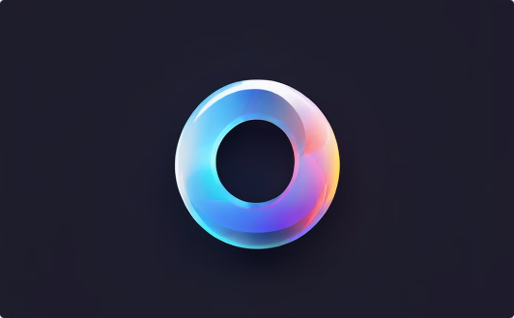
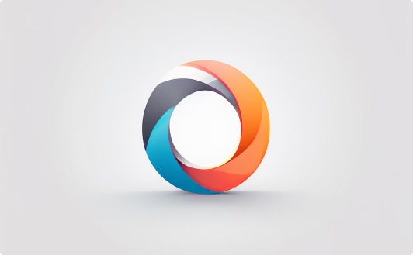
Technology Stack
Python
OpenAI API
GROQ API
Python, a versatile and beginner-friendly programming language, serves as the core of our system's codebase, enabling efficient data processing and model training.
The powerful OpenAI API provides advanced natural language processing capabilities, allowing us to leverage cutting-edge language models for user profile generation.
GROQ, a scalable and flexible query language, empowers our system to efficiently extract and organize user attributes from the generated profiles.

Slide 5
Experiments
Batch Processing
1
Tweets were processed in batches to generate user profiles using the powerful OpenAI language model.
2
Field Extraction
A specialized extract_field function was developed and tested to reliably retrieve specific attributes from the generated profiles.
Mock Data Validation
3
Initial tests were conducted using mock data to validate the accuracy and robustness of the extraction logic.

Slide 6
Results
Jeff Bezos: The user, likely Jeff Bezos, is philanthropic, supportive, humble, curious, and passionate. They are involved in space exploration, reading, travel, and sports. They like Amazon, space exploration, philanthropy, family, literature, music, and food. They dislike inflation, misinformation, censorship, climate change, and injustice. Overall, the user values family, learning, innovation, and making a positive impact on the world.
Justin Bieber: The user's main personal traits include being family-oriented, loving, supportive, charitable, passionate, dedicated, grateful, reflective, empathetic, and humorous. They are also hardworking, creative, and adventurous. In terms of hobbies, the user enjoys performing, creating music, collaborating with other artists, supporting charitable causes, playing hockey, traveling, and spending time with family and friends. They also engage in activities like watching movies, playing sports, making videos, and interacting with fans on social media. The user likes spending time with family, performing live, supporting charitable organizations, creating music, collaborating with other artists, and playing hockey. They also enjoy interacting with fans, promoting positivity and kindness, and supporting friends and family. On the other hand, the user dislikes injustice, suffering, negativity, false accusations, and being misunderstood. They also dislike rumors, hate, negative comments, and being away from loved ones. Additionally, they are not fond of canceling shows, delays in releasing new music, and negative media attention. Overall, the user's profile reflects a caring, dedicated, and passionate individual who values family, music, charity work, and positive interactions with others. They strive to make a positive impact and spread love and kindness in their endeavors.
Oprah Gail Winfrey: The user is compassionate, empathetic, and spiritual, with a strong focus on supporting others and promoting positivity. They enjoy engaging in meaningful conversations, hosting events, and watching TV shows that highlight important social issues. The user dislikes negativity, discrimination, and lack of empathy, and is passionate about advocating for social justice and mental health awareness. They also appreciate spiritual teachings, empowering stories, and celebrating achievements. Overall, the user values authenticity, kindness, and personal growth in themselves and others..

Slide 7
Observations
Dataset Limitations
Field Coverage
The dataset lacked diversity and was not extensive enough to accurately capture all user traits such as age, name, and post history.
Some attributes, like age and name, were challenging to extract consistently due to incomplete or inconsistent data.
Insights and Patterns
Challenges
Despite limitations, the analysis revealed common interests and behaviors among users, such as frequent mentions of technology and AI.
Variability in user language and the informal nature of tweets posed significant challenges to data extraction and profile accuracy.

Slide 8

Conclusions
The project successfully developed a system to profile Twitter users based on their tweets. I used both OpenAI(gpt-3.5-turbo-0125) and Lama(llama-3.1-70b-versatile) to profile eight users based on their tweets, aiming to infer personal traits such as likes, dislikes, hobbies, and age. The generated profiles were compared with publicly available information, revealing that while the LLM accurately identified several traits, there were notable gaps due to the limited dataset. These gaps resulted from the insufficient number and variety of tweets, leading to incomplete profiles. The accuracy and detail of the profiling were found to be heavily dependent on the diversity and richness of the tweet data. Users with more varied tweets had more accurate profiles, whereas those with fewer tweets had less detailed profiles. This underscores the importance of having a comprehensive dataset for effective social media analysis. Future efforts should focus on expanding the dataset to improve the accuracy and completeness of user profiling.

Slide 9
Future Work
Enhanced Data Collection
1
Improve data collection methods to ensure a more diverse and comprehensive dataset, covering a wider range of user traits.
2
Multimedia Profiling
Extend profiling capabilities to include analysis of videos and images for a more holistic understanding of user profiles.
Fine-Tuning Models
3
Perform fine-tuning on existing models to enhance performance and accuracy in extracting user attributes.
4
Real-Time Profiling
Develop real-time profiling capabilities to analyze and update user profiles dynamically as new data becomes available.
Handling Sarcasm and Emojis
5
Improve the system's ability to detect and interpret sarcasm and the use of emojis, which can significantly impact the accuracy of sentiment and attribute extraction.

